Slide 1
AI Research Agent (RAG): LLM-powered tool for querying private document PDF sets
Team RAG
https://github.com/Sid1125/Primitive-Research-RAG

Slide 2
Project Name
About our Team
Team RAG
AI Research Agent (RAG): LLM-powered tool for querying private document PDF sets
Team Members – Siddharth Sinha - Lead
Course: SIC Artificial Intelligence
Amity University Haryana – B-25019

Slide 3
AI Research Agent (RAG): LLM-powered tool for querying private document PDF sets
Problem Statement
Organizations and students often store important information in PDF documents such as manuals, reports, notes, and technical guides. Searching these documents manually is time-consuming and inefficient. Traditional keyword search often fails to understand context and meaning, while general AI models may generate incorrect answers if they are not grounded in source documents.
Therefore, the problem is to build a system that can intelligently read private PDF documents, retrieve the most relevant information, and generate accurate, context-based answers for user queries.

Slide 4
AI Research Agent (RAG): LLM-powered tool for querying private document PDF sets
Objective of the Project
The main objective of this project is to develop an LLM-powered Retrieval-Augmented Generation (RAG) system that can answer user questions from private PDF documents. The system is designed to extract text from PDFs, preprocess and chunk the content, retrieve the most relevant information using hybrid search, and generate accurate, context-aware answers using a lightweight local LLM. The goal is to make document understanding and information retrieval faster, more intelligent, and more reliable.

Slide 5
AI Research Agent (RAG): LLM-powered tool for querying private document PDF sets
Proposed Solution
Our proposed solution is an LLM-powered RAG system that reads private PDF documents, extracts and preprocesses their text, divides the content into smaller chunks, and stores them in a searchable knowledge base. When a user asks a question, the system retrieves the most relevant chunks using hybrid retrieval and then uses a lightweight local LLM to generate a grounded answer from the retrieved content.
The system combines dense semantic retrieval and lexical retrieval, which improves answer relevance for technical documents. It also supports lightweight local LLM generation through Ollama, making the solution practical for private and low-resource environments.
Unique Features -
Supports private PDF-based question answering
Uses hybrid retrieval for better relevance
Integrates a lightweight local LLM using Ollama
Falls back to extractive answering if generation is unavailable
Uses a custom Keras embedding model instead of relying only on external models

Slide 6
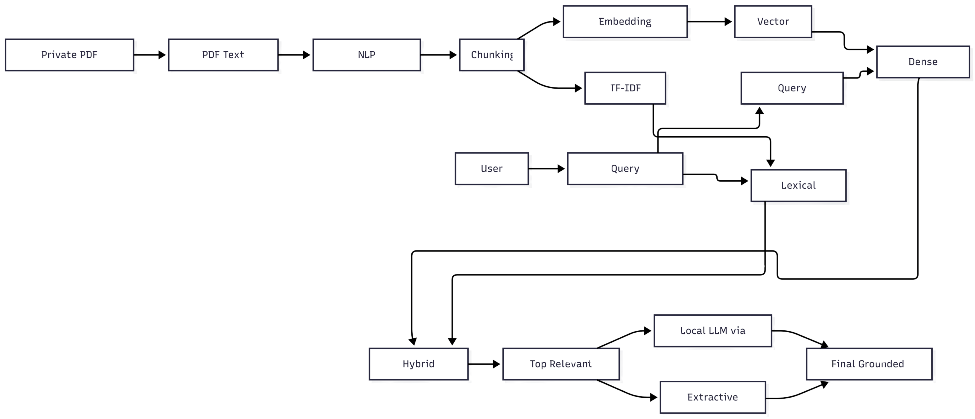
AI Research Agent (RAG): LLM-powered tool for querying private document PDF sets
System Architecture / Flow Diagram
Block diagram of system
Flow of data Input → Processing → Output

Slide 7
AI Research Agent (RAG): LLM-powered tool for querying private document PDF sets
Tools, Technologies & Libraries
Project Type: AI / NLP / RAG
Language: Python
Libraries: NLTK, TensorFlow, Keras, NumPy, scikit-learn, PyMuPDF
Tools: Jupyter, VS Code, GitHub, Ollama
Dataset Source: Custom private PDF files

Slide 8
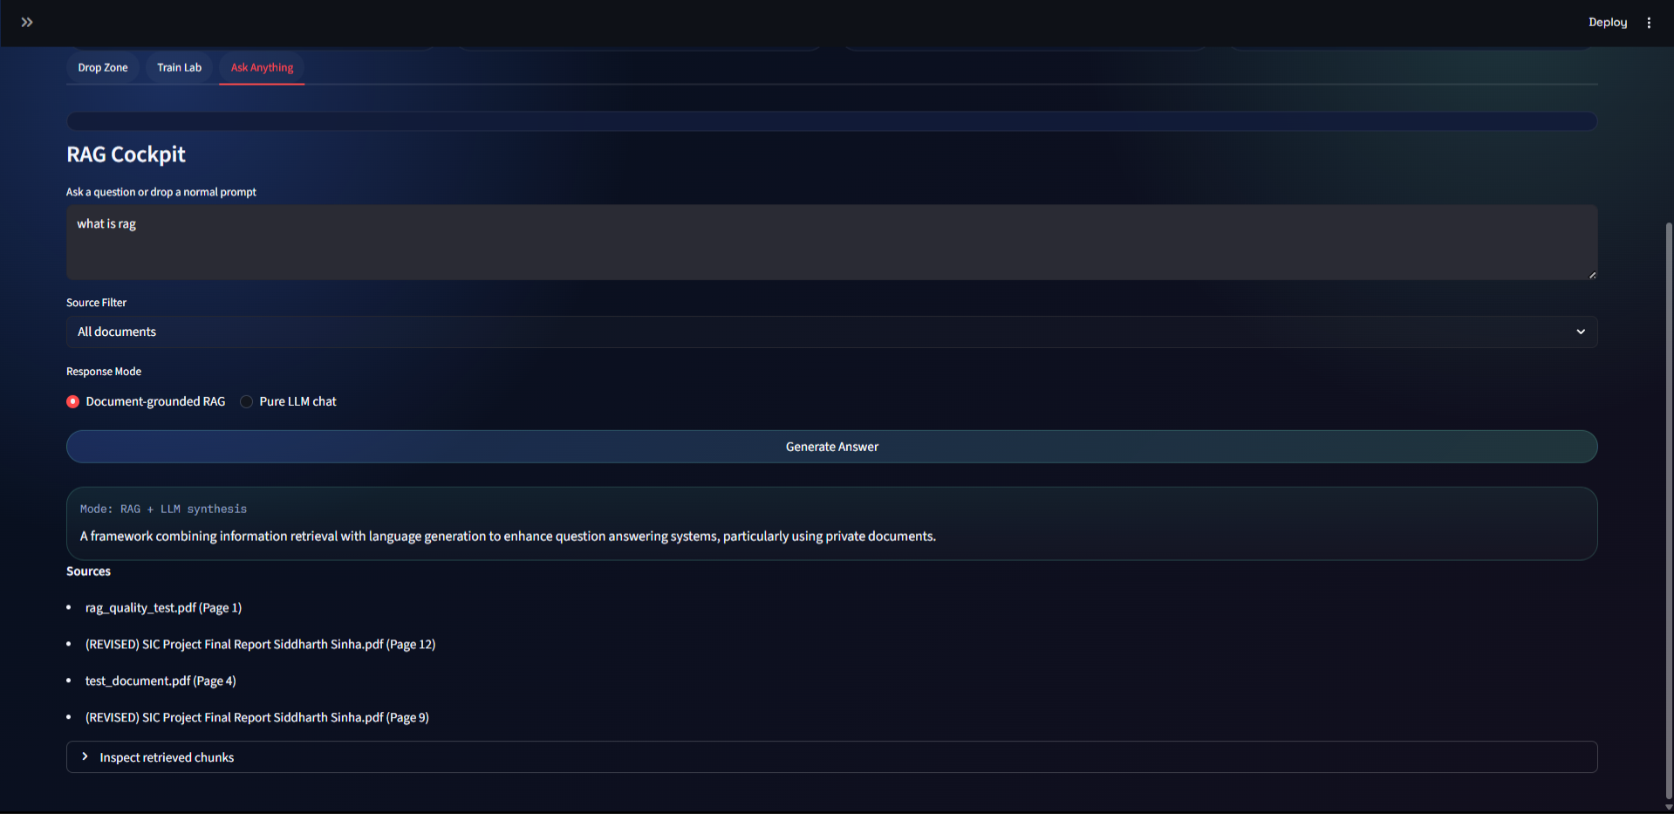
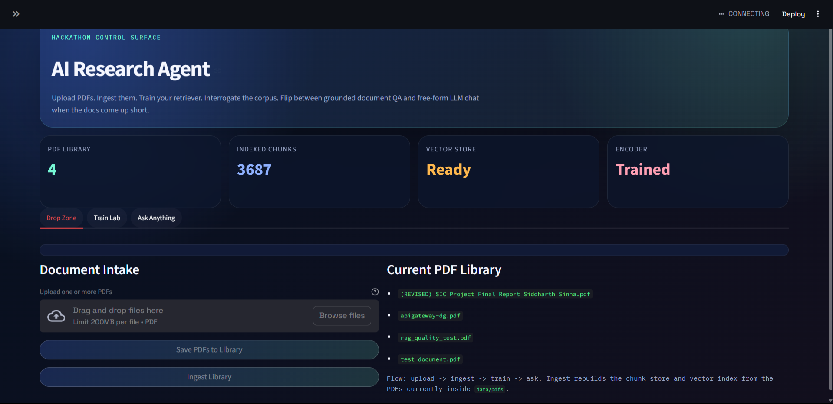
AI Research Agent (RAG): LLM-powered tool for querying private document PDF sets
Project Screenshots / Project Designs
Insert UI designs,
model output screenshots,
architecture visuals, etc.
Output
Ingest Function

Slide 9
AI Research Agent (RAG): LLM-powered tool for querying private document PDF sets
Results & Performance
Result / Final Outcome:
The project successfully developed an LLM-powered RAG system for private PDF question answering. The system can ingest PDF documents, preprocess and chunk text, retrieve relevant content using hybrid retrieval, and generate grounded answers using a lightweight local LLM through Ollama.
Key Findings:
Hybrid retrieval improved answer relevance compared to basic retrieval alone. The use of a local LLM produced more natural answers than extractive-only methods. The system worked effectively on private PDF collections and demonstrated a complete end-to-end pipeline.
Challenges Faced:
Major challenges included noisy PDF text extraction, selecting the right chunk size, retrieving relevant content from very large technical PDFs, and reducing repeated or incomplete answers. Integrating local LLM generation while keeping answers grounded was also an important challenge.
Future Scope:
The project can be improved further by adding better reranking models, support for more document types, improved citation highlighting, stronger local models, and better PDF structure understanding.
Features to be Added:
Planned features include a frontend interface for user interaction, drag-and-drop PDF upload, chat-style document querying, source highlighting, answer citation display, multi-document filtering, conversation history, and support for additional local LLM models.

Slide 10

Thank You
Open for Questions
Samsung Innovation Campus

